Slide 1
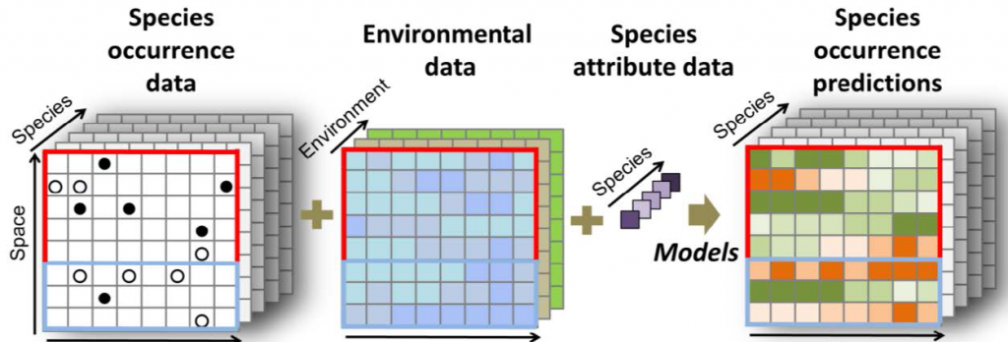
Species Distribution Modeling (SDM) Ecological Niche Modeling (ENM) Habitat Suitability Modeling (HSM)
Using
MaxEnt
Sreehari Raman
Dept. of Wildlife Science
College of Forestry
Kerala Agricultural University

Slide 2
Why SDM?
Its a process used to predict the potential distribution of species across geographical areas based on environmental variables and species occurrence data.
SDM combines statistical and machine learning techniques with environmental data to model the ecological requirements of a species and its relationship with the environment.

Slide 3
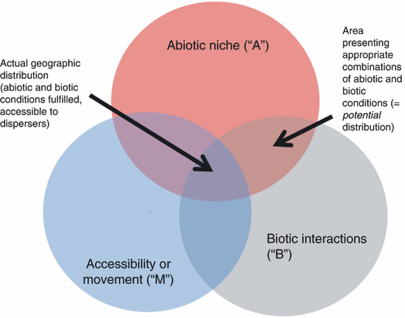
BAM diagram
(Peterson 2011)

Slide 4
Step involved
Identify your target species
Give importance to
Endemic/rare or sp. with restricted distribution
Keystone sp. or ecologically important sp.
Threatened sp. or Data Deficient or Non-evaluated sp.
Explore IUCN Redlist (www.iucnredlist.org) for details on conservation status, distributional range, population trends etc.
Step 1

Slide 5
Formulate the Hypothesis and Objectives
To estimate the current/potential distributional habitats
To understand the environmental correlates of species occurrences
Forecast future distributional ranges under changing climatic conditions
Predict species richness in case of multiple species
Designing new industrial/human areas to have a minimum impact on species
Planning new protected areas to best protect current biodiversity
Step 2

Slide 6



Distribution data (primary or secondary)
Primary source: Field survey
Secondary source -online database, publications, social media, interview etc.
www.gbif.org
www.ebird.org
www.inaturalist.org
www.amphibiaweb.org
World Register of Marine Species www.marinespecies.org
Marine data layer for ecological modelling www.bio-oracle.org
All your data must have the same coordinate system WGS84
Convert all data to Decimal Degree (DD) and CSV format
Step 3
Presence only data

Slide 7
Data Format
Species | Latitude | Longitude
Elephas_maximus | 77.25479 | 10.1425
Elephas_maximus | 76.59078 | 11.29955
Elephas_maximus | 76.84086 | 11.34383
Elephas_maximus | 77.00886 | 10.19816
Elephas_maximus | 76.71092 | 11.41866
Elephas_maximus | 76.80027 | 11.3571
Elephas_maximus | 76.71092 | 11.41866
Elephas_maximus | 77.25479 | 10.1425
Anthus_nilghiriensis | 76.91373 | 11.36613
Anthus_nilghiriensis | 77.0351 | 10.14666
Anthus_nilghiriensis | 77.26492 | 10.01754
Anthus_nilghiriensis | 77.26492 | 10.01754
Anthus_nilghiriensis | 77.061 | 10.08944
Anthus_nilghiriensis | 77.25479 | 10.1425

Slide 8
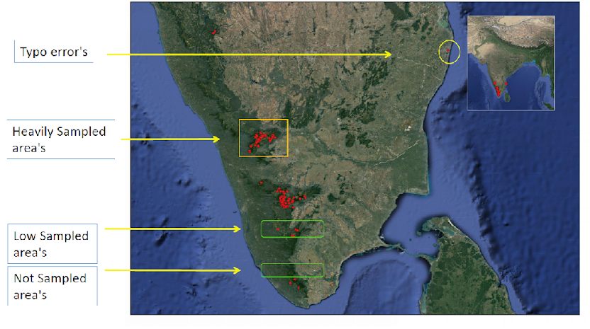
Plot your Observations on a Map!!

Slide 9
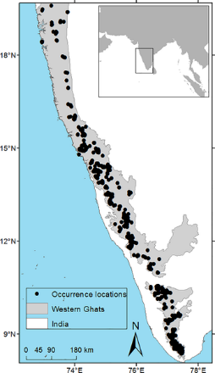
Spatial Thinning
Process of reducing the number of presence points for a species while maintaining the spatial distribution and ecological characteristics of the original data
R package spThin
Manual thinning is time consuming
Advantages of spatial thinning includes:
Avoid spatial autocorrelation
Overfitting prevention
Reducing sampling bias
Enhancing model transferability
Reducing computational demands
Smoother response surfaces
Step 4
(Aiello-Lammens et al. 2014)

Slide 10
When not to use Spatial Thinning?
Study using primary occurrence data
Species having sparse secondary occurrence data
Small study area

Slide 11
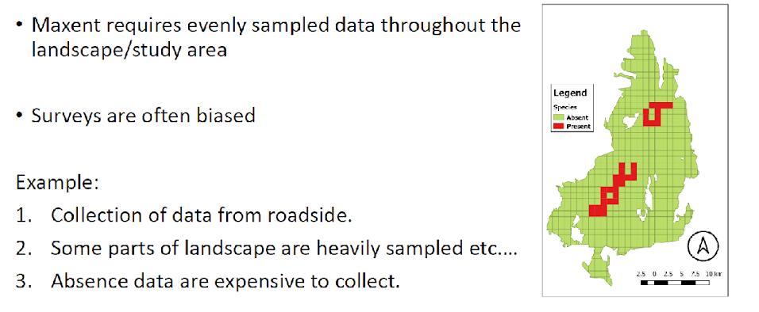
Bias in Species distribution data

Slide 12
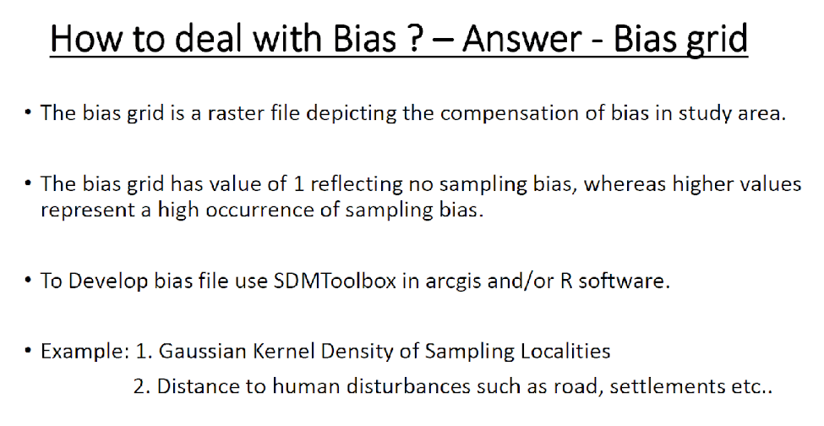

Slide 13
Identify the environmental variables
A) Biotic variables
Tree cover/density/height, NDVI, Canopy openness, etc..
B) Abiotic variables
Climate data (Temp, precipitation etc…)
Topographic (Elevation, Slope, Aspect, etc..)
Soil properties (Soil type, pH, nutrient content etc..)
Distance to water bodies
Distance to forest/human settlements
Human influence variables (like urbanization, deforestation etc. can have significant impact on species distribution)
Step 5

Slide 14
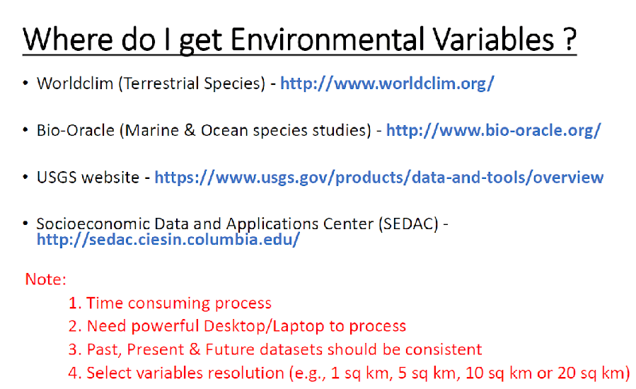

Slide 15
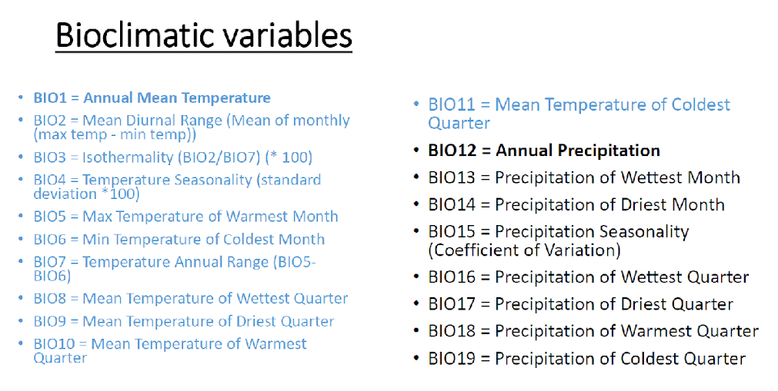

Slide 16
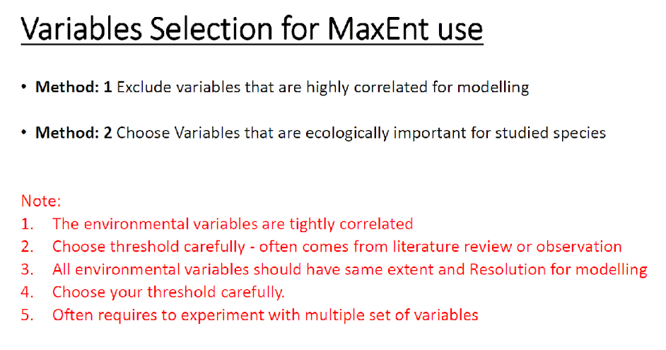

Slide 17
Environmental data in ASCII format
Environmental data must have:
The same cell size
The same number of rows and columns
The same extent

Slide 18
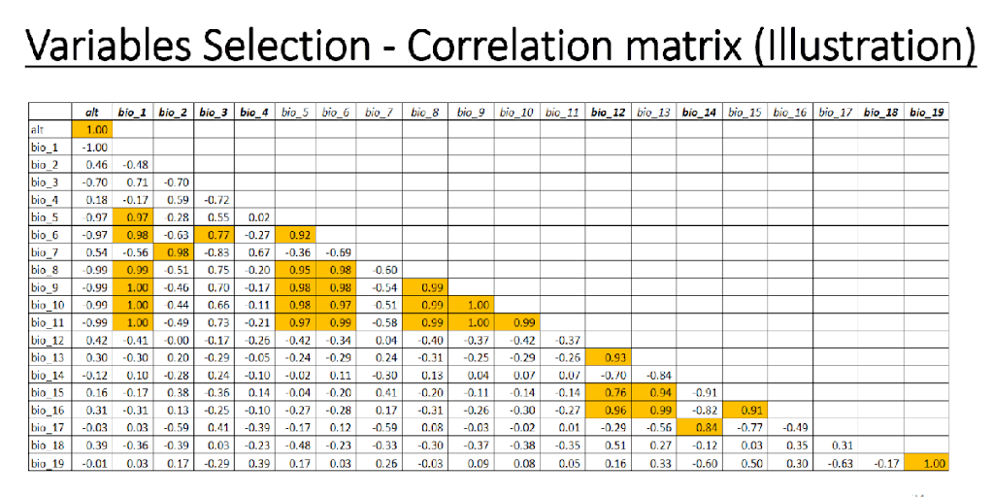

Slide 19
Variable selection for current and future predictions?
Static variables: These variables do not vary with time and are considered fixed during the modeling process. Ex: elevation, slope , aspect, soil type or distance to certain features (e.g., water bodies or roads).
Dynamic variables: These are variables that change over time or across different instances of the data. Ex. temperature, precipitation, or vegetation indices that vary seasonally or annually.
The selection of variables depends on the specific research question, the availability of data, and the ecological characteristics of the species being modeled. The goal is to identify the most relevant environmental variables that influence the species' distribution pattern and predict its potential habitat.

Slide 20
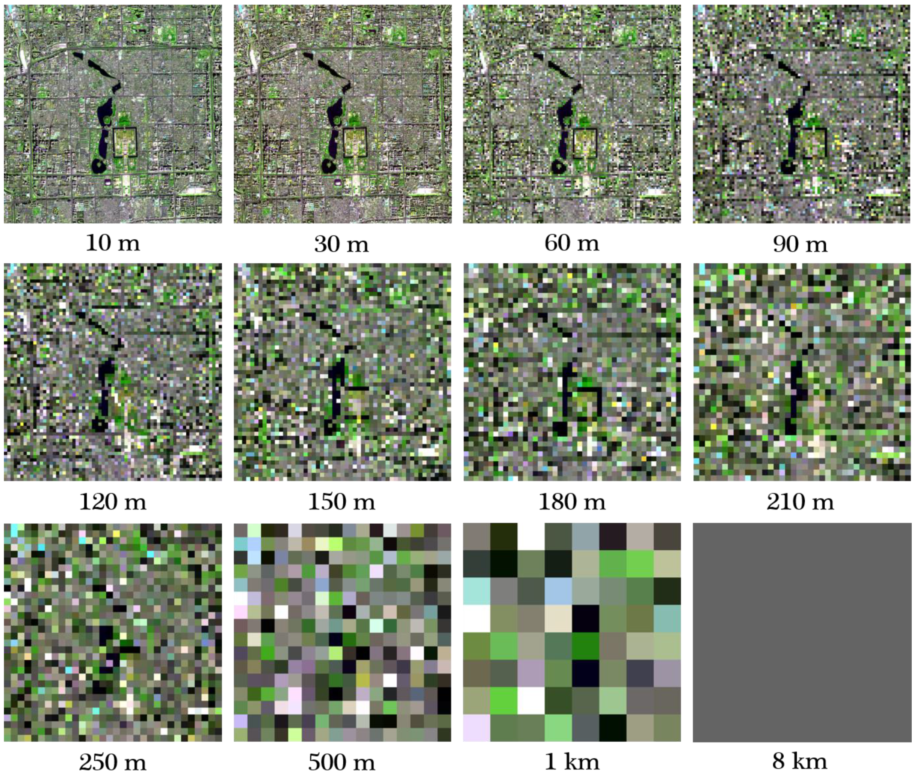
Q. Shall I select high resolution or low resolution imageries????
Spatial resolution

Slide 21
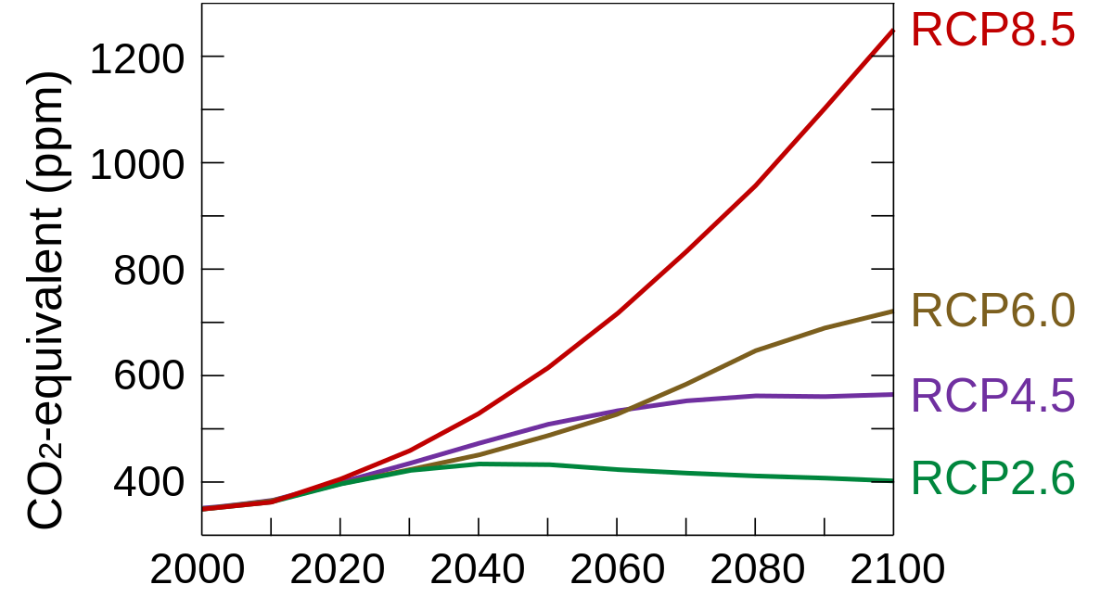
IPCC-The Intergovernmental Panel on Climate Change United Nations body for assessing the science related to climate change.
Future Species Distribution Models
Assessment Report AR5 2014
Consists of three Working Group contributions and a Synthesis Report
Representative Concentration Pathway (RCP) is a greenhouse gas concentration trajectory by the IPCC AR5

Slide 22
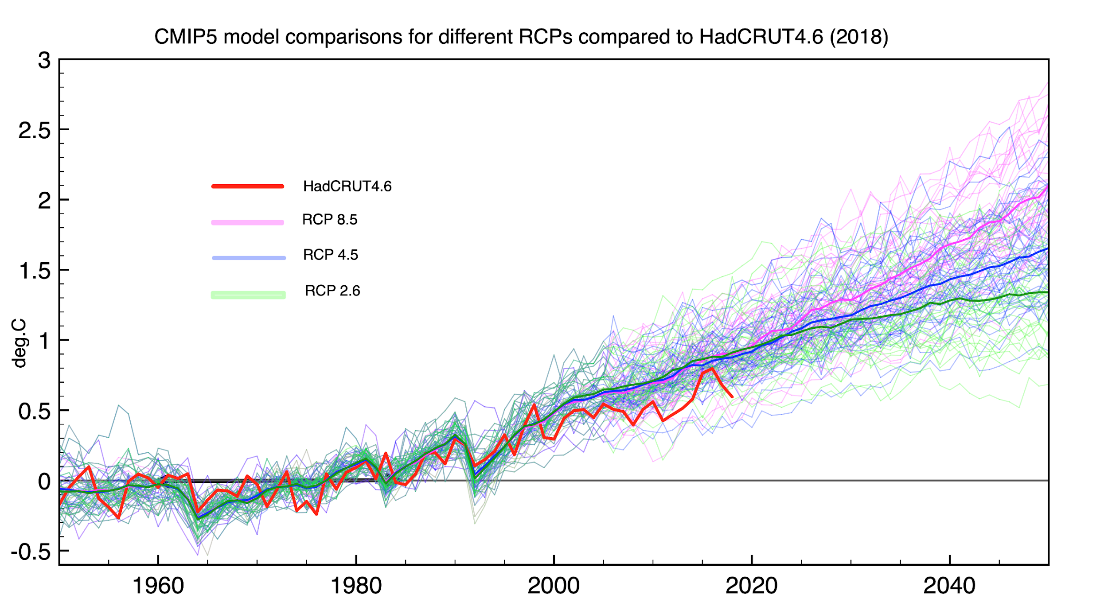
CMIP5 Coupled Model Intercomparison Project Phase 5 (CMIP5)
CMIP5 involved numerous climate modeling groups worldwide, running multiple climate models under different scenarios to provide a more robust and comprehensive assessment of climate projections. The results from CMIP5 were used to synthesize the climate projections in IPCC AR5.
20 climate modeling research groups around the world with 40 GCM-covered the historical period (1850-2005) and future scenarios (2006-2100).
Hadgem-2 Climate Model is widely used for Indian scenario

Slide 23
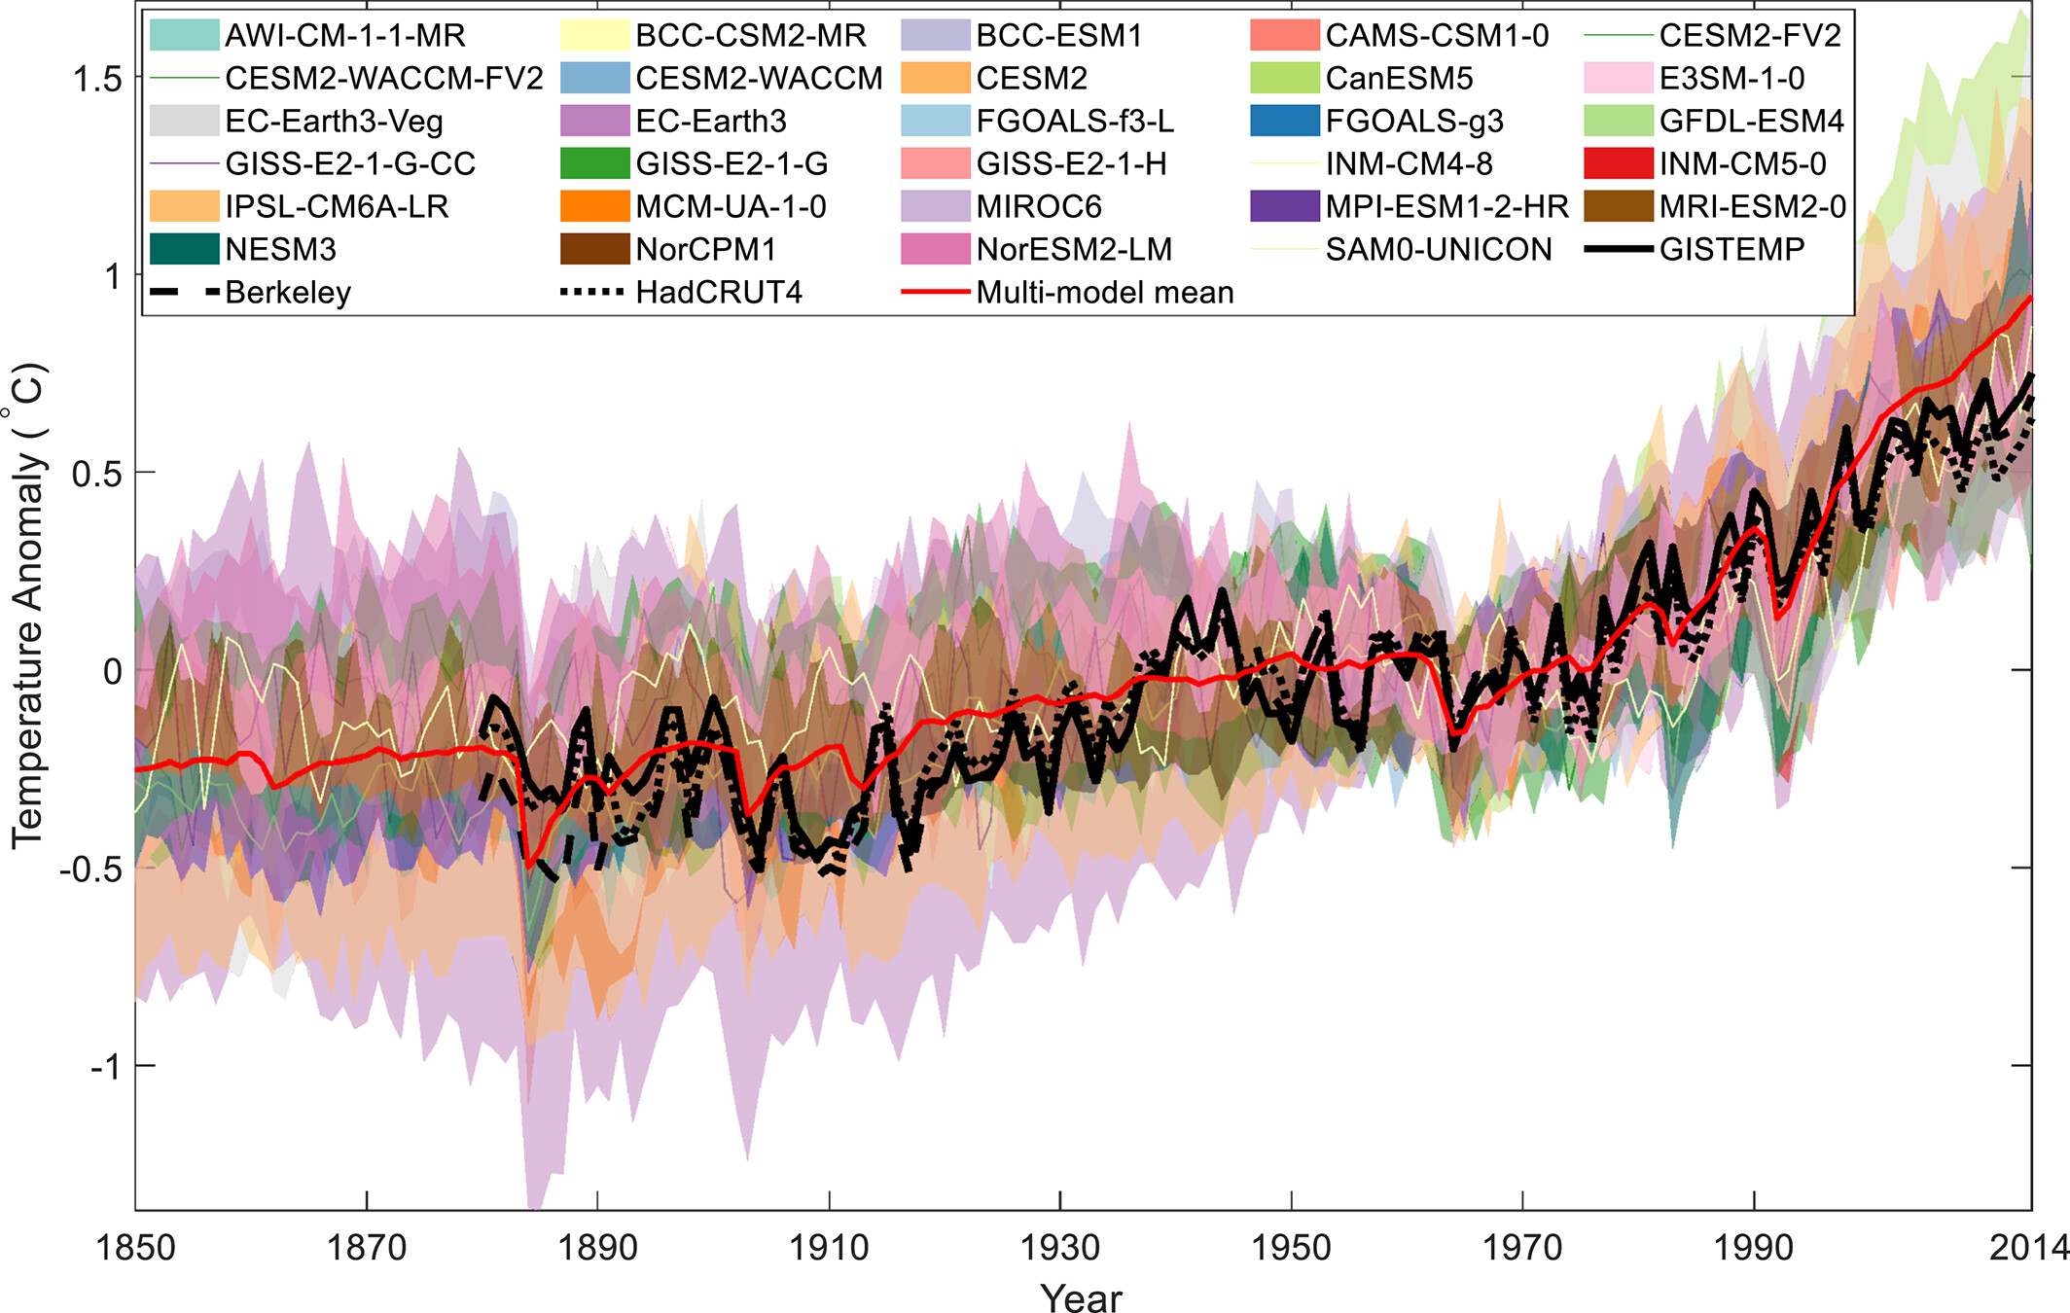
CMIP6 Broader historical period (1850-2014) and more extended future period (2015-2300) compared to CMIP5
IPCC AR 6- March 2023
Shared Socioeconomic Pathways (SSPs)-cover a wider range of future greenhouse gas emissions and socio-economic conditions.
Included certain models with higher spatial resolution
(SSPs): 126, 245, 370 and 585.
Period: 2021-2040, 2041-2060, 2061-2080, 2081-2100

Slide 24
Species Distribution Modelling
There are several software options available for running niche modeling
Maximum Entropy (MaxEnt)
R (packages like dismo, biomod2, ENMeval, SDMTools, presence, Rmaxent etc..)
Arc GIS (SDM Toolbox)
OpenModeller
Step 6

Slide 25
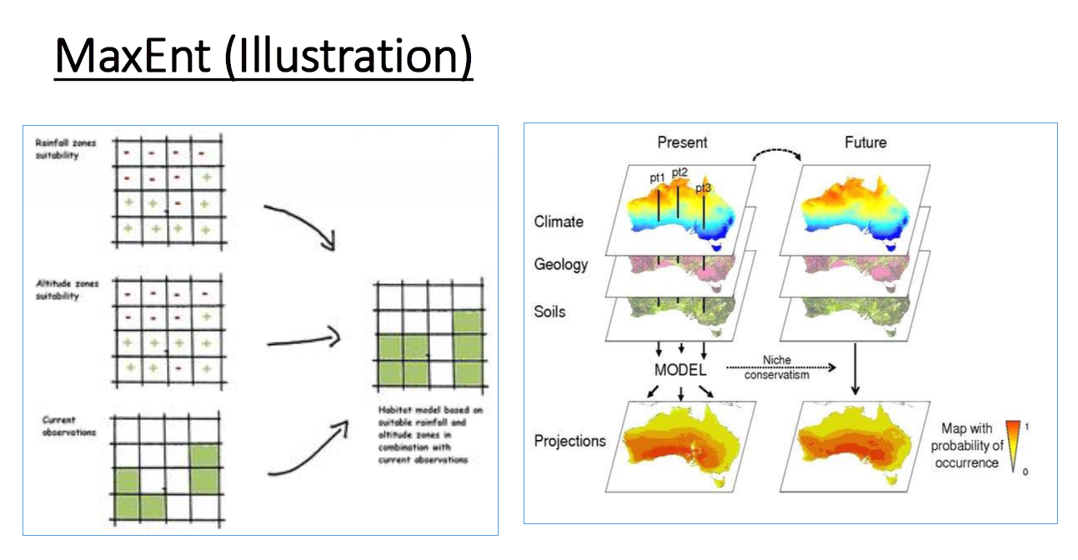

Slide 26
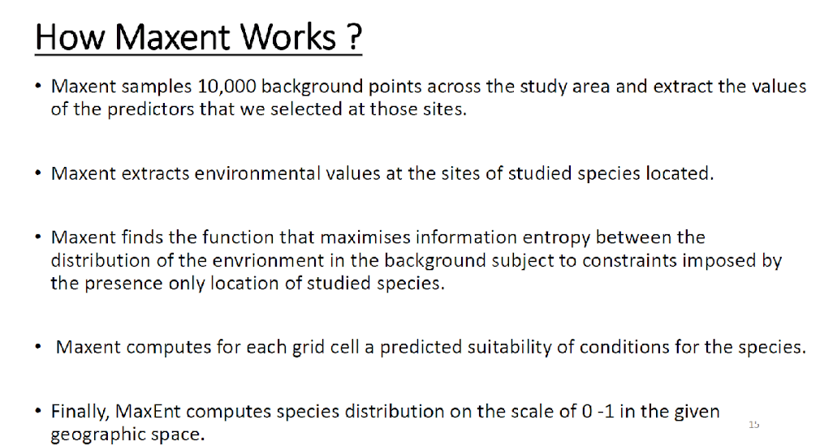

Slide 27
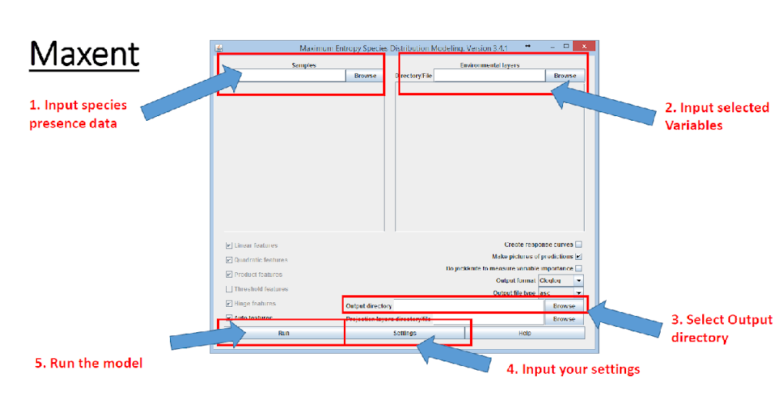

Slide 28
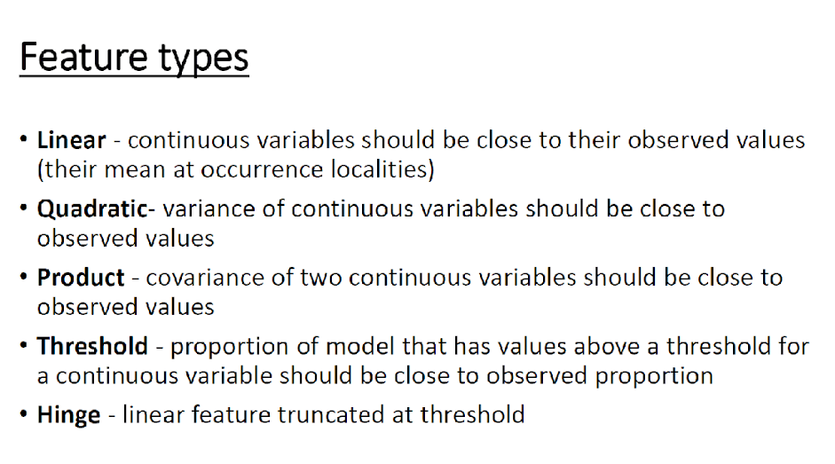

Slide 29
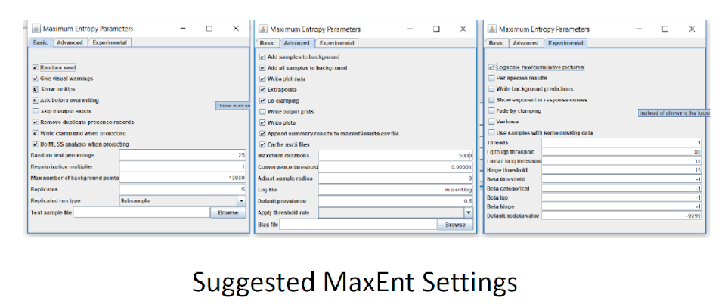

Slide 30
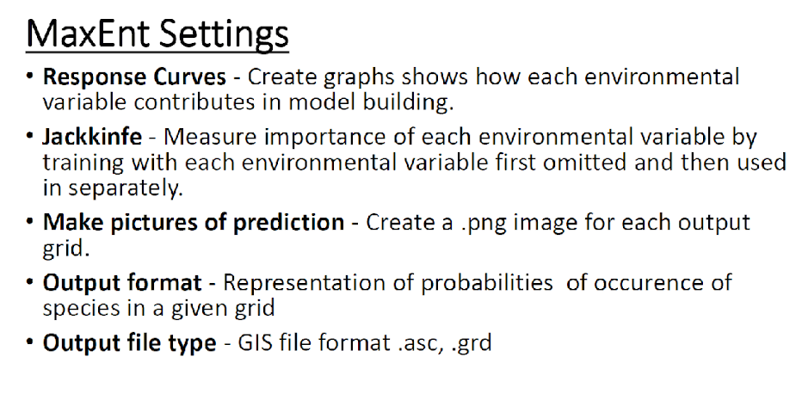

Slide 31
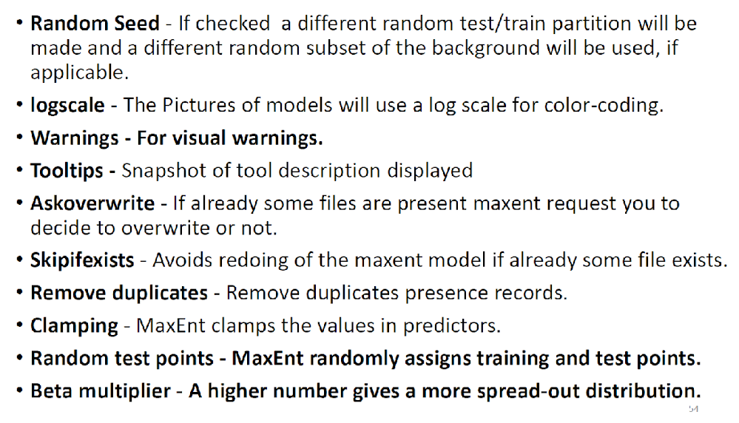

Slide 32
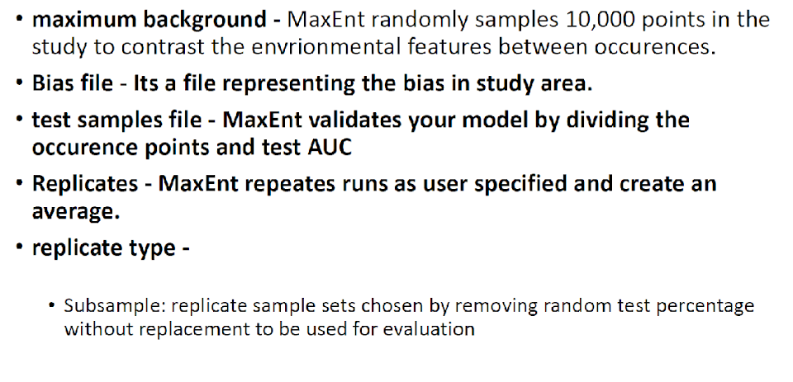

Slide 33
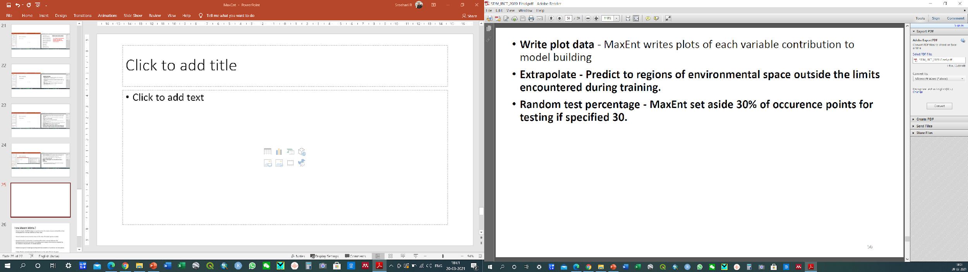

Slide 34
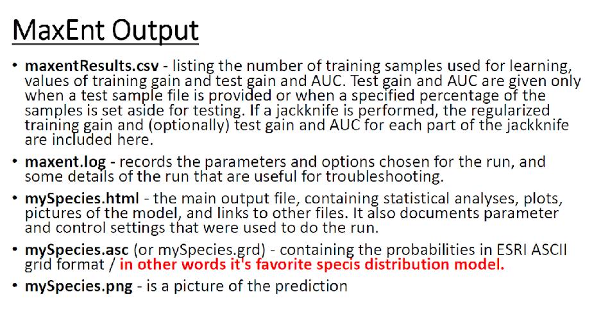

Slide 35
Model validation
1. AUC (Area Under the Receiver Operating Characteristic Curve)
It plots the True Positive Rate (TPR) against the False Positive Rate (FPR).
A higher AUC indicates better discrimination power of the model, with 1.0 being a perfect score
2. Kappa (Cohen's Kappa)
A Kappa value of 1 indicates perfect agreement, 0 indicates agreement no better than chance, and negative values suggest agreement worse than chance.
It is particularly useful when dealing with imbalanced datasets
3. TSS (True Skill Statistic):
A binary classification that considers both sensitivity and specificity. It is defined as TSS = Sensitivity + Specificity – 1
Values ranges from -1 to 1. A TSS value of 1 indicates perfect classification, 0 indicates no skill, and negative values suggest worse-than-chance performance.
Step 7

Slide 36
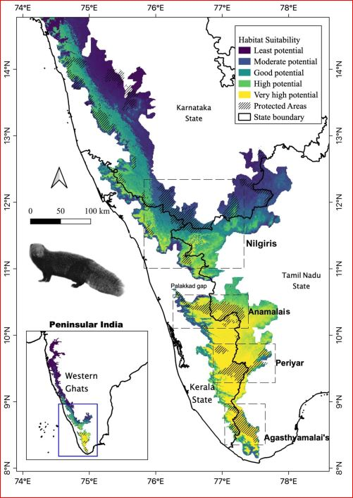
Habitat Suitability index
Habitat Suitability Index
0 - 0.25 Low suitable area
0.25 - 0.5 Moderately suitable area
0.5 - 0.75 Good/ suitable
0.75 - 1.0 Highly suitable
Raman et al. 2020

Slide 37
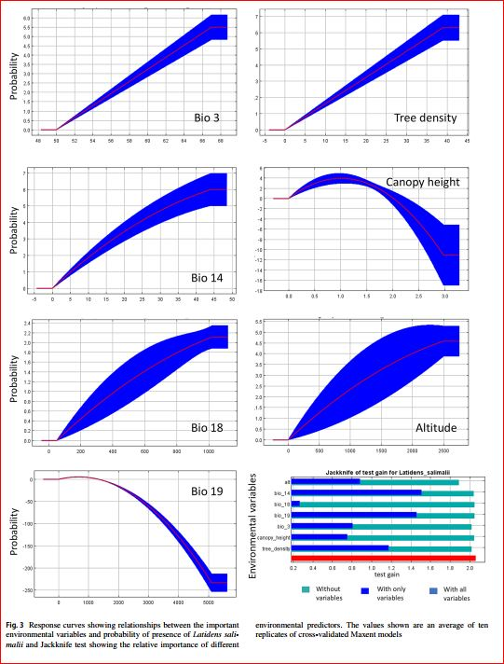
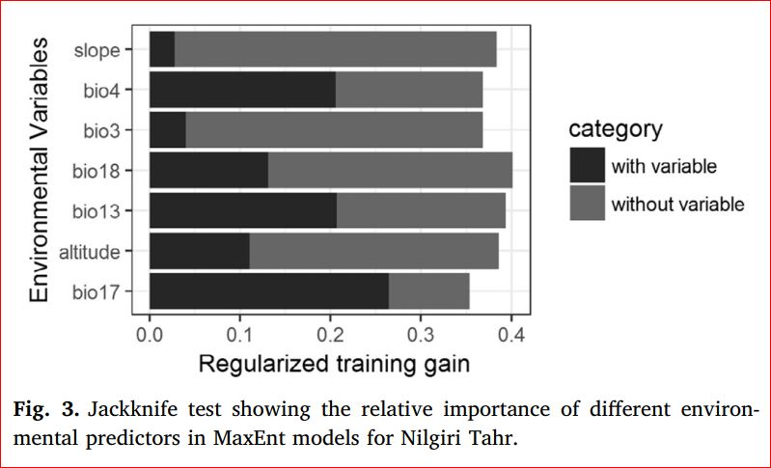
Important parameters and response curve
Sony et al. 2018
Raman et al. 2020

Slide 38

Publish your results
Step 8

Slide 39
End of session 1

